Slide 1
Predicting Stock Prices with Genetic Programming
CMPU 365
Spring 2013

Slide 2
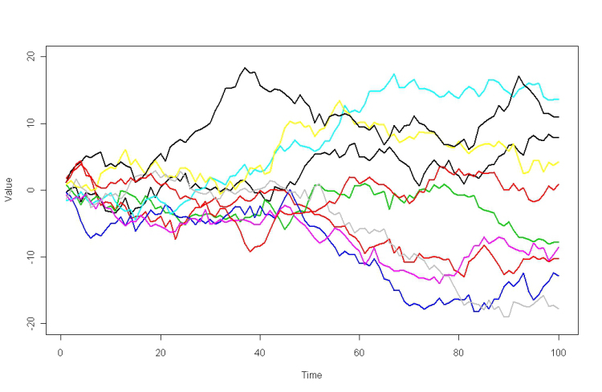
The Problem
Create a program that will give a reasonably accurate prediction of the closing price of a given stock tomorrow using information available now
Why is this such a difficult problem?
According to the prevailing theories stock prices are inherently random and impossible to predict.
What makes you think you’ve got a chance?
Genetic programs are inherently flexible and if some nonlinear predictive relation exists this is one of the best ways to find it.

Slide 3
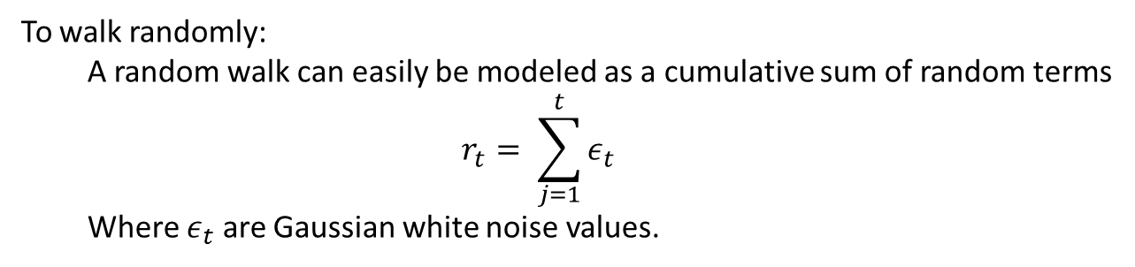
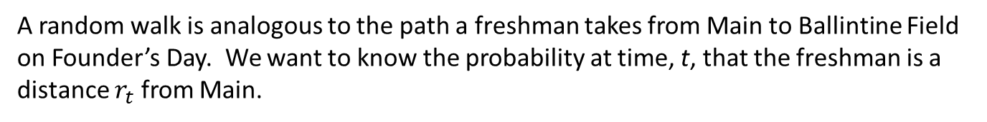
The Problem
Random Walks
A random walk is analogous to the path a freshman takes from Main to Ballintine Field
on Founder’s Day. We want to know the probability at time, t, that the freshman is a distance $r_{t}$ from Main.
The efficient market hypothesis:
All available information has already been priced into the market
In other words, you’re screwed and financial analysts have the same success rate as a monkey
To walk randomly:
A random walk can easily be modeled as a cumulative sum of random terms
$$r_{t}= \sum_{j=1}^{t}{ε_{t}}$$
Where $ε_{t}$ are Gaussian white noise values.

Slide 4
Approach and Implementation
What is a Genetic Algorithm?
An algorithm for search and optimization, based on the principles of Darwinian evolution
Create a group of M INDIVIDUALS, call that group a generation, G_{i}
Each individual represents a possible solution to the problem
Now take the best individuals from that generation and combine them to create a new generation of individuals with desirable traits from the previous generation
;;;========================
;;; INDIVIDUAL-STRUCT
;;;========================
(defstruct individual
program
(raw-fitness 0)
(standardized-fitness 0)
(adjusted-fitness 0)
(normalized-fitness 0))

Slide 5
Approach and Implementation
Genetic Programming vs. Genetic Algorithms
In classic Genetic Algorithms the individuals are represented by fixed-length bit strings
I’m using variable-length function (trees) instead
As it turns out, this is really easy to do in LISP because a function can be composed as a list and easily evaluated with EVAL

Slide 6
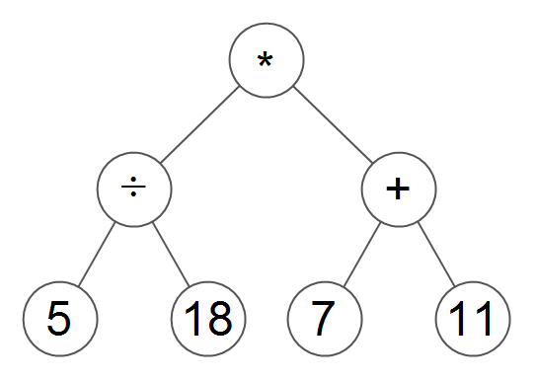
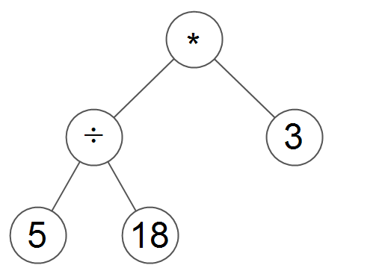
Generating Individual Functions
Full Tree
Function set
The set of functions available
E.g. { +, -, *, / }
Terminal Set
Set of terminals available
Open, high, low, close price from yesterday, etc.
Grown tree

Slide 7
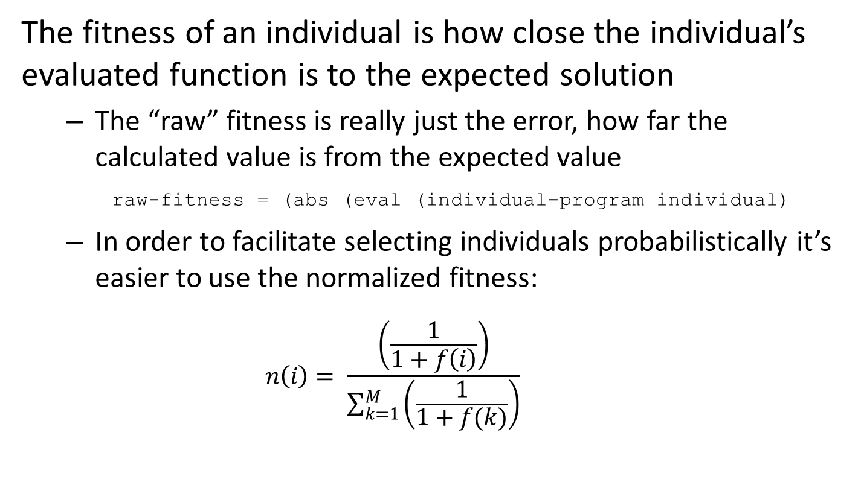
Fitness
The fitness of an individual is how close the individual’s evaluated function is to the expected solution
The “raw” fitness is really just the error, how far the calculated value is from the expected value
raw-fitness = (abs (eval (individual-program individual)
In order to facilitate selecting individuals probabilistically it’s easier to use the normalized fitness:
$$n\left(i\right)= \frac{\left(\frac{1}{1+f\left(i\right)}\right)}{\sum_{k=1}^{M}{\left(\frac{1}{1+f(k)}\right)}}$$

Slide 8


“Breeding”
There are two options for creating new individuals from the current generation
Darwinian Reproduction
Mutation

Slide 9
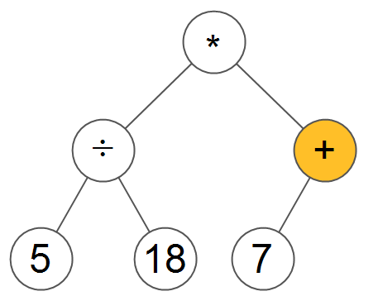
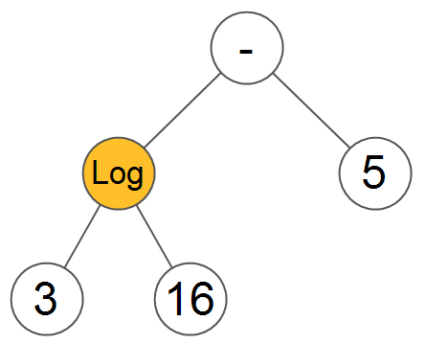
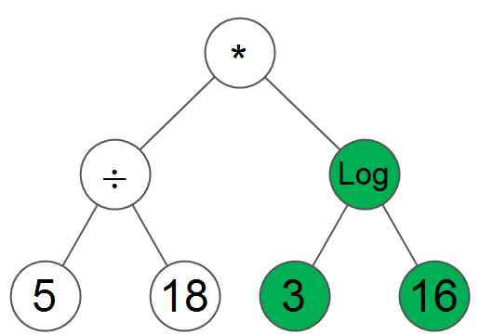
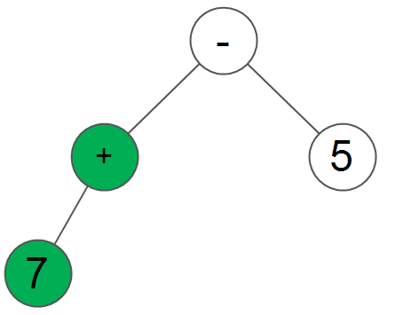
Crossover
In Genetic Programming Darwinian Reproduction is called Crossover
Parents
A node from each parent tree (function) is selected as a crossover point. The crossover point is the root of a new subtree and the subtrees are swapped.
This allows for great variation in potential trees as they can grow bigger and smaller depending on the crossover point selected.
Children

Slide 10
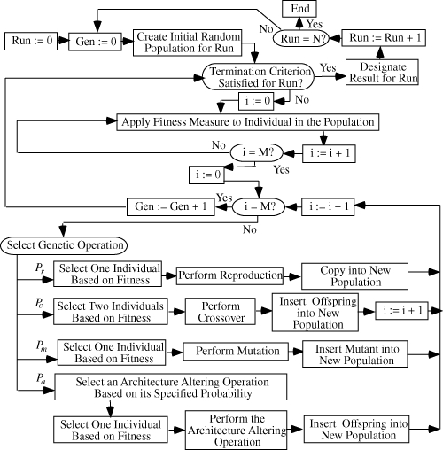
Rinse and Repeat
The rest is just iterating the process for a set number of generations or until an individual arises that satisfies the desired parameters.

Slide 11
Testing
Testing is done with historical data (1960s-70s) on different companies with differing input data.
As the program learns and the overall fitness of the population increases, the algorithm should converge on a solution.
Once the initial parameters are optimized the algorithm will be trained and tested on data sets of progressively longer time periods and various prediction dates.

Slide 12
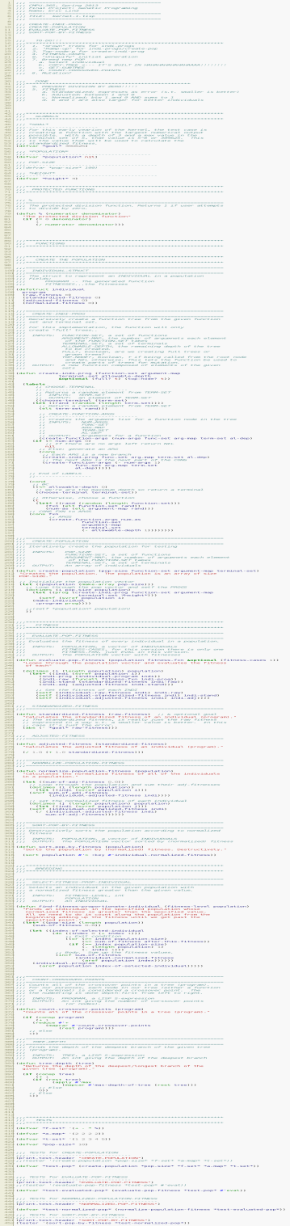
Status
The Kernel
The basic set of functions for implementing a genetic algorithm
About 80% complete
The problem-specific implementation:
About 10% done, but luckily there’s not much to do
The data
Mostly in Excel

Slide 13
Plans
Finish the kernel
Write an Excel macro or a batch script to pull data from yahoo finance and format it properly
Test runs with simple problems
Optimize initial parameters
Profit?

Slide 14
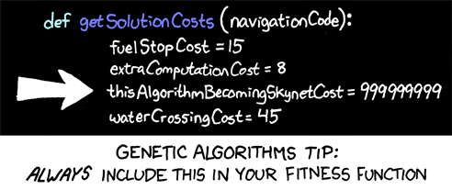
FIN

Slide 15
Photo Credits
Random walk graph: Rabett, Open Mind Blog http://tamino.wordpress.com/2010/03/11/not-a-random-walk/
Evolution: http://investmentpropertycentral.org/the-evolution-of-a-property-management-company/
Flow Chart: Koza, http://www.genetic-programming.com/gpflowchart.html
Ninja Turtles: http://nebezial.deviantart.com/art/teenage-mutant-ninja-turtles-121465691
Jokes: http://xkcd.com/534/

